Slide 1

Credit Consumption Prediction Challenge Hackathon
TEAM Name : Greyelectrons
Team Members :
1.Ashwin Tiwari 3.rizwan alvi
2.Iftekar patel 4 .Surojit nath

Slide 2
Problem statement :
The Common Man Bank Ltd (CMB) wants to understand the spending patterns of the customer and get insights on the customer persona.
Data of sample customers and their transaction history was provided from their database.

Slide 3
Potential Business Problems :
To predict average spend of a customer in coming 3 months (July, August & September).
Depending upon Spending, the banks the build strategic partnerships with vendors for discounts or other plans to reward and retain customers.
Run optimized campaigns to retain and increase the customers, and thereby increase the bank revenue ?
Stakeholder :
1.Board of Director
2.Managing director
2.Bank Manager

Slide 4
DATA:
The daTA consists of records of roughly 15000 TRANSACTION and 44 features. There are 43 predictors and 1 target that describes customer expenditure for upcoming 3 monthS.
Below are some of the features
Variable | Description
account_type | Account Type – current or saving
age | Age of customer
cc_cons_apr | Credit card spend in April
dc_cons_apr | Debit card spend in April
cc_cons_may | Credit card spend in May
dc_cons_may | Debit card spend in May
cc_cons_jun | Credit card spend in June
debit_amount_apr | Total amount debited for April
credit_amount_apr | Total amount credited for April
max_credit_amount_apr | Maximum amount credited in April
debit_amount_may | Total amount debited for May
credit_amount_may | Total amount credited for May
max_credit_amount_may | Maximum amount credited in May
debit_amount_jun | Total amount debited for June
credit_amount_jun | Total amount credited for June
max_credit_amount_jun | Maximum amount credited in June
emi_active | Monthly EMI paid to other bank for active loans
Target Feature :
Variable | Description
cc_cons | (Target) Average Credit Card Spend in next three months

Slide 5
1.Analysis of data :
First step we did is we used describe and info function on the dataframe following are the point we analysed:
Personal loan, vehicle_loan_active, personal_loan_closed and vehicle_loan_closed column can be dropped because its standard deviation is zero .
Investment_4 column is dropped because it has zero correlation with target and around 25% of data is negative value which cannot be normalized using square root or log function.
Need to work on outliers of multiple columns
No Such Null values present in data.
Using corr() function we came to know there is less correlation among the data

Slide 6
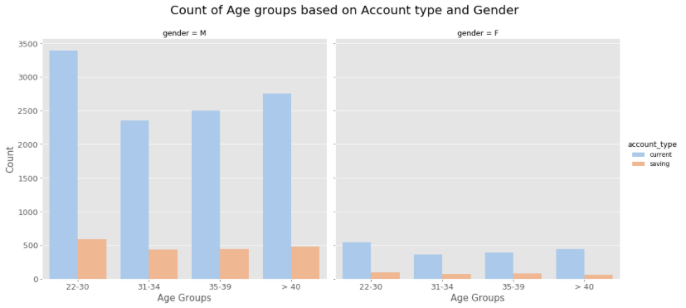
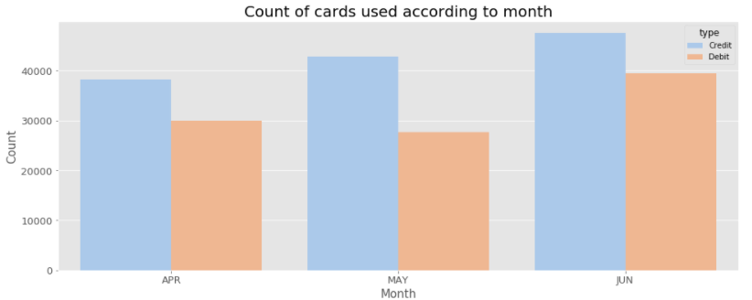
Analysis of data :
Most of the customers are having current account
Majority of the customers are male
Age group of 22-30 have max current account
After observing the above count we can make out that cmb bank customers are using credit card more than debit card.
one can also observe that for both debit and credit card the number of transaction is increasing for each month.
It also seems like people are happy with credit card of cmb bank because they might be getting more rewards like cashbacks and discount for transaction made with credit card
The usage of debit card is less it might be possible that people might be having less savings in their bank account

Slide 7
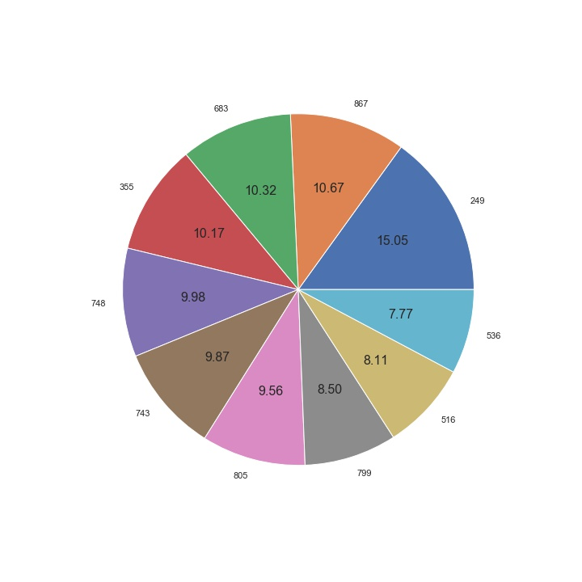
Analysis of data :
Pie chart beside represents top 10 region where the consumption was maximum.
Region code : 249 have max 15.05 %
Region code 249 have the maximum consumption

Slide 8
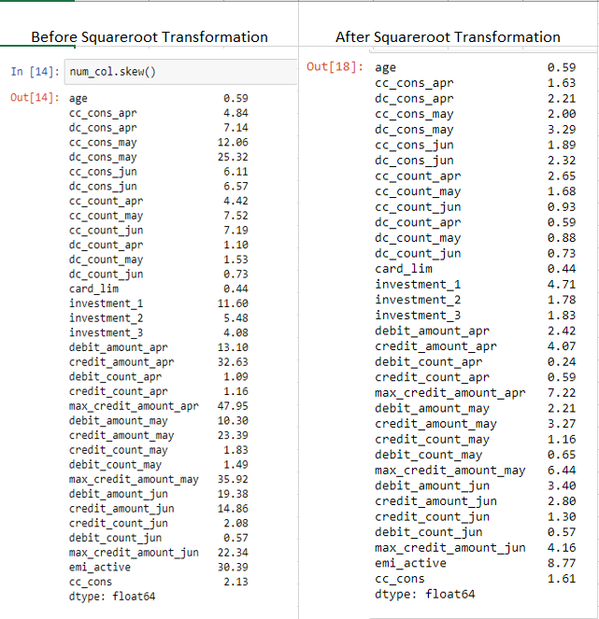
1.Removing Skewness:

Slide 9
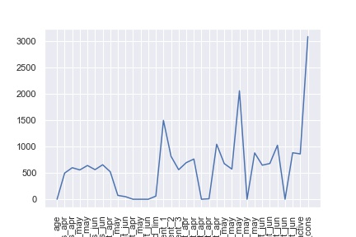
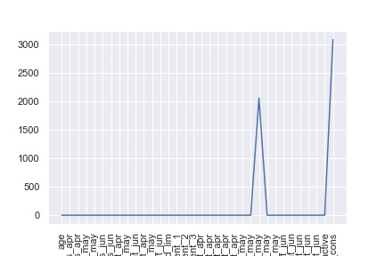
1.Removing Outliers
Before Outlier treatment After Outlier treatment

Slide 10
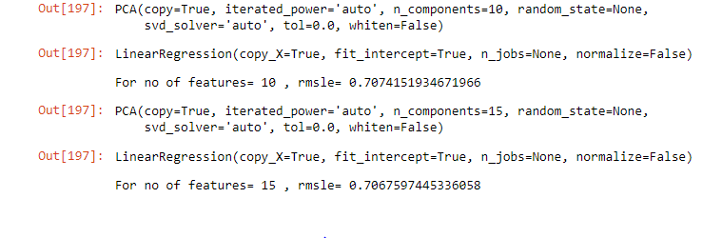
Feature Selection :
PRINCIPAL COMPONENT ANALYSIS :By using PCA method we get to know the best number of features and In our case it was 15 however PCA method does not provides the feature names so we used recursive feature elimination and we also created a function which gives the feature names depending upon the correlation.

Slide 11
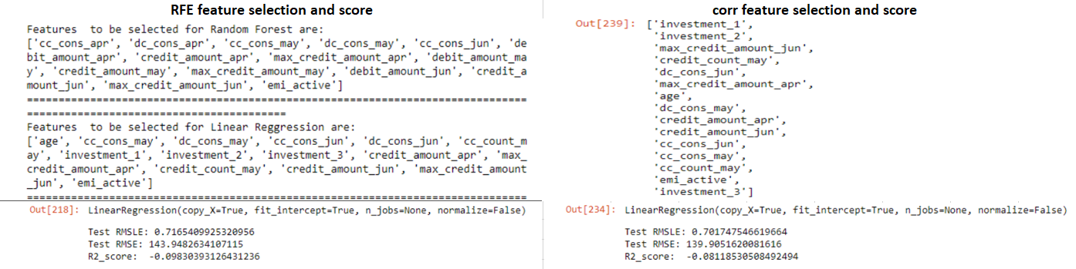
Feature Selection :
Recursive feature elimination : Eliminate the least importance feature and provide only relevant feature name but however when we used rfe it provided us with less RMLSE value so method we used the method which we created.

Slide 12
Model and Approaches
Models Assessed : The Vanilla models used yielded the following results below
Modelling Method | RMSLE | RMSE
Linear Regression | 0.7176 | 144.06
Lasso | 0.7166 | 143.99
Ridge | 0.7178 | 144.11
PCA + Linear Regression | 0.7067 | 140.13
Gradient Boosting | 0.317 | 213.22

Slide 13
Model Tuning
After performing hyperparameter tuning using Grid Search and treating imbalanced classes, the following results were observed on the features selected using correlation method and yielded the following results:
Modelling Method | RMSLE | RMSE
RandomizedSearchcv+Random Forest | 0.718 | 144.11
RandomizedSearchcv+XGB Regressor | 0.7277 | 144.8
RandomizedSearchcv+DecisionTree Regressor | 0.7166 | 143.99

Slide 14
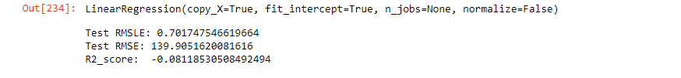
Conclusion
After performing hyperparameter tuning using Random Search and treating outliers, the following results were observed on the features selected using correlation method and yielded the following results:
Due to insufficient data we were not able to build crisp model
The best model we got was a linear regression model for our problem
Also XGBoost dose’nt gives best result always.
We were not able to get a clear insight about the spending pattern of the customer for the reward based schemes.

Slide 15


